Slide 1
Debugging and Analysis tools.
Sri Ram Sagar K

Slide 2
"Most good programmers do programming not because they expect to get paid or get adulation by the public, but because it is fun to program"
--Linus Torvalds.

Slide 3
Lecture Flow
Step 1>>>> Debugging using Spyder 3 editor.
Step 2>>>> Static code analysis[pylint].
Step 3>>>> Exercise.

Slide 4
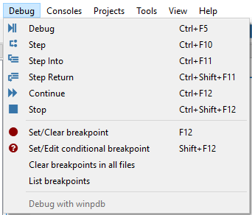
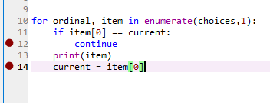
Step 1>>>> Debugging using Spyder 3 editor.

Slide 5
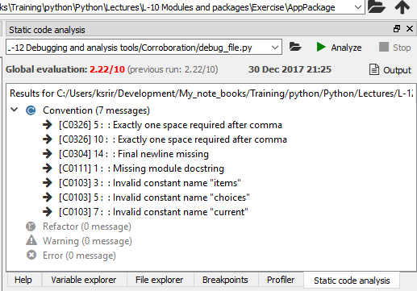
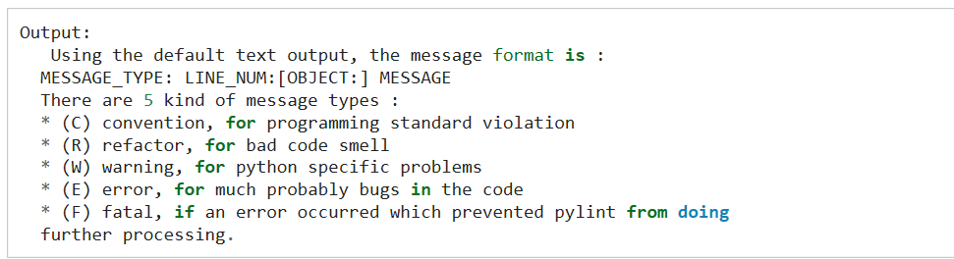
Step 2>>>> Static code analysis[pylint].
Descriptive analysis output.

Slide 6
Step 2>>>> Static code analysis[pylint] (cont.).
Pylint basic through anaconda console environment.
Pylint debug_file.py
Pylint debug_file.py --reports=n #suppress extensive report.
Pylint debug-file.py --help-msg=invalid-name #message label will be in (label).
Pylint debug_file.py --reports=n --disable=invalid-name

Slide 7
Step 3>>>> Exercise.
Question1: Create a module of Pythagorean triplets and check the coding standard using static code analysis and import the score of the program.
Mute all invalid naming messages through pylint.
Question2: Run debug over corrected program from Question1 and try out all functions and explain step into and step return.

